Slide 1

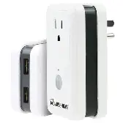

ENGINEERING DESIGN
PROJECT
Smart Plug
Presented by SSRT Group

Slide 2
PROBLEM
People usually leave their fan running
through the night while they sleep. But
sometimes they wake up needing to turn it off because it’s too cold.
Also in offices and homes, a lot of power is wasted because of fans running when people aren’t using them.

Slide 3
SOLUTION
A universal smart plug that connects at the power supply to the fan.
This provides the following features:
  Automatic ON/OFF based on temperature and humidity.
  The ability to set a timetable for the fan to turn off automatically.
  Remote control via a mobile app.

Slide 4
GOALS
  Energy Efficiency: Reduces unnecessary power consumption.
  User-Friendly: Provides remote control and scheduling via a mobile app.
  Affordability: A cost-effective smart home solution.

Slide 5
PROOF OF CONCEPT
We conducted the google survey to check whether the problem we identified is a concern for the public and to find the public opinion

Slide 6
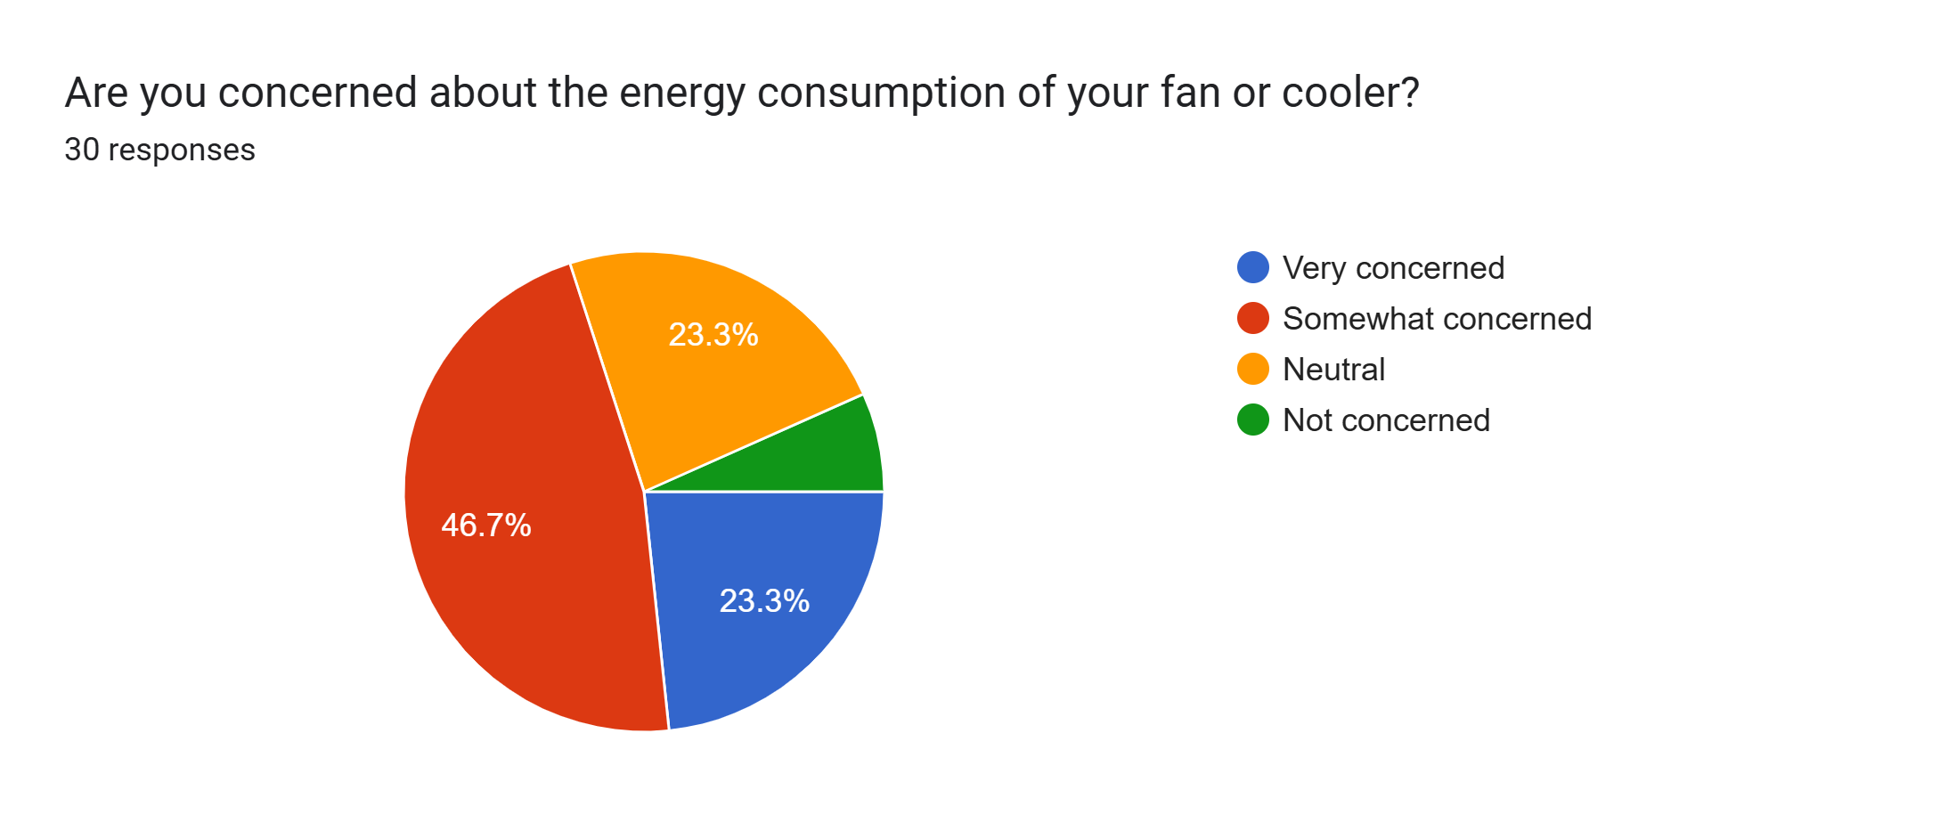

Slide 7
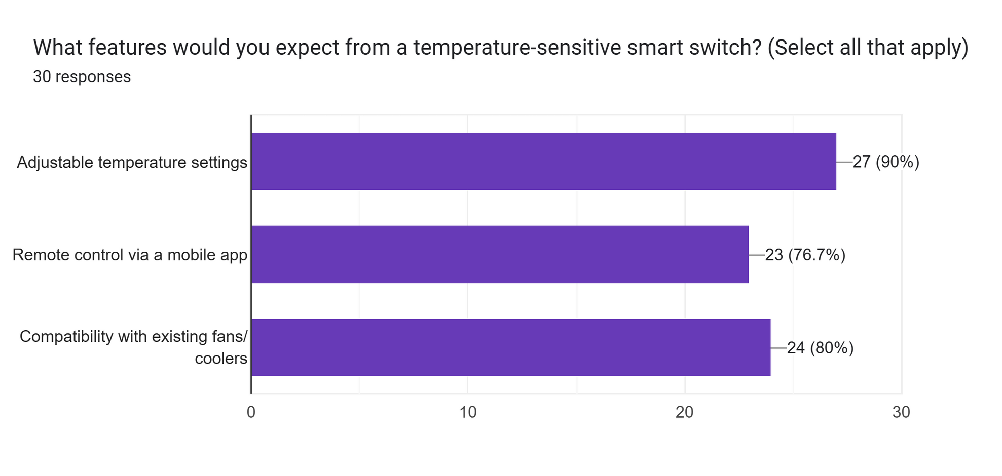

Slide 8
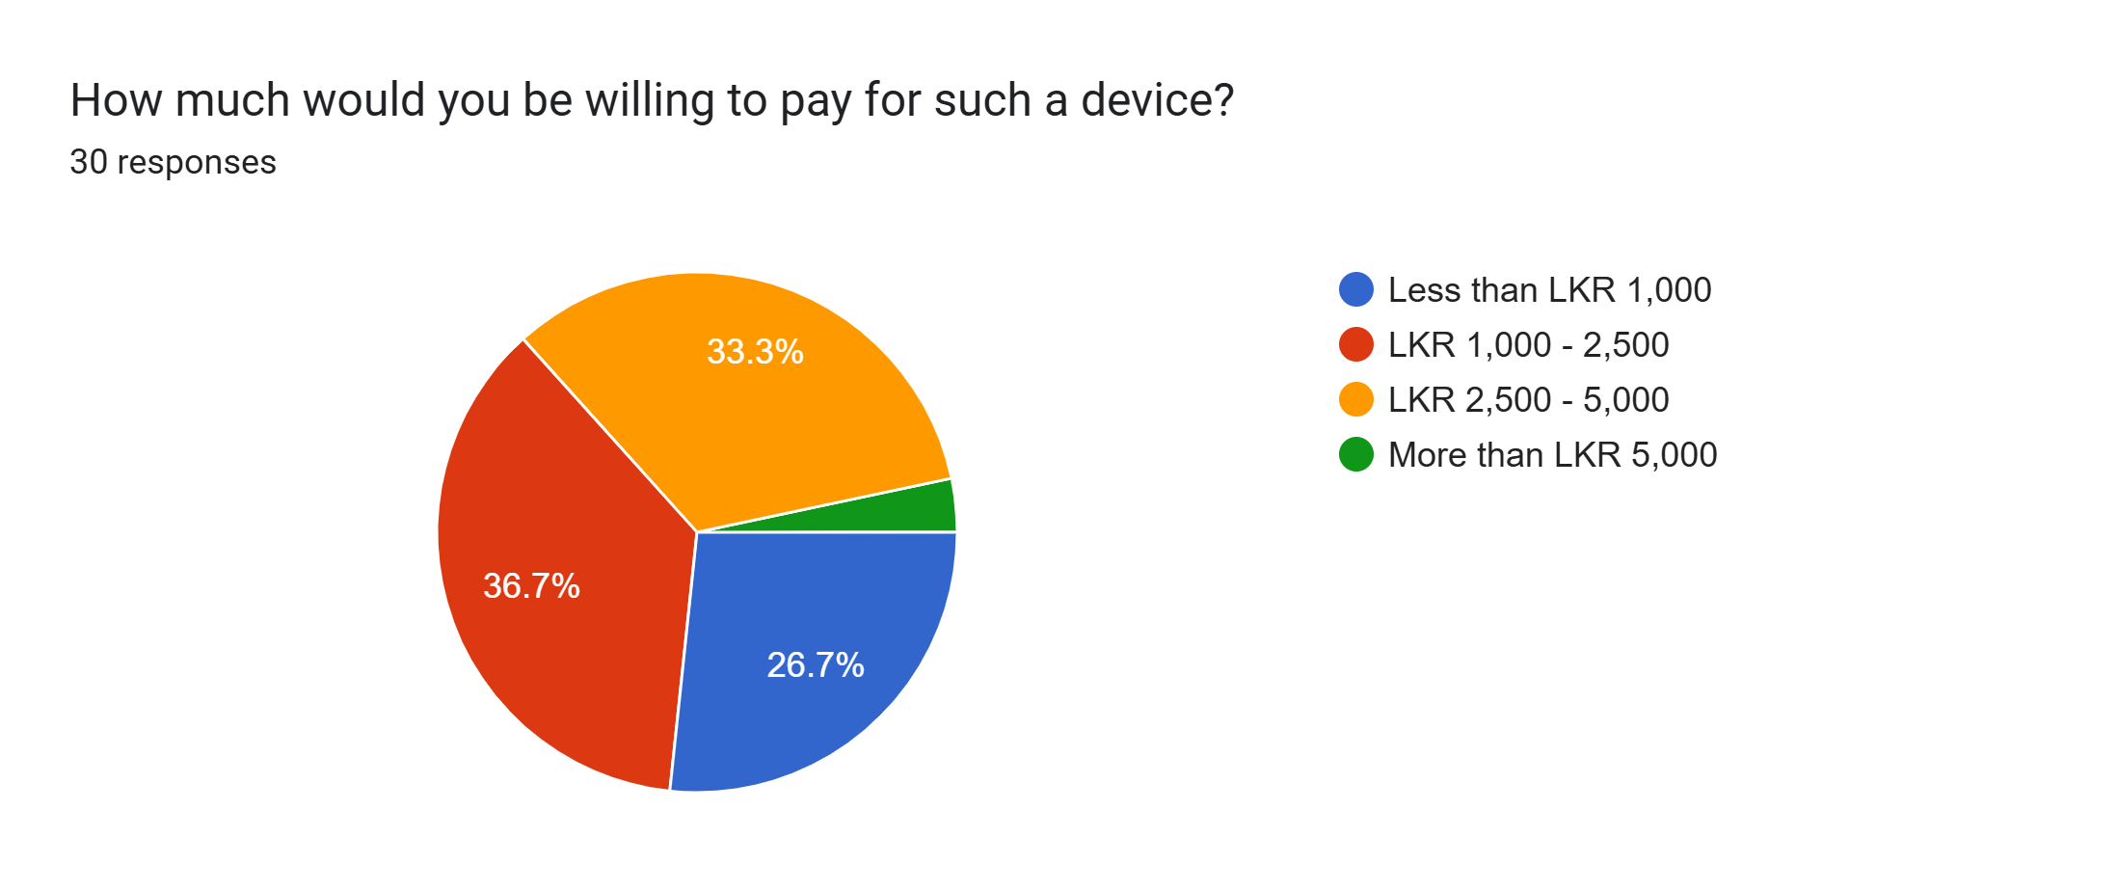

Slide 9
MODULES WE USE
  Microcontroller: ATmega328
  Relay Module: MD0486
  Bluetooth Module: HC-05
  Sensors: DHT11 (Temperature Humidity)
  Display: LCD 1602
  Clock: DS1302 Real-Time Clock

Slide 10
RESULTS UP TO NOW
  Making the prototype using Arduino board.
  PCB designing completed.
  Basic enclosure design in done.
  Arduino code completed.

Slide 11
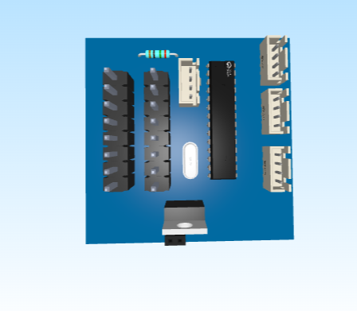
PCB DESIGN

Slide 12
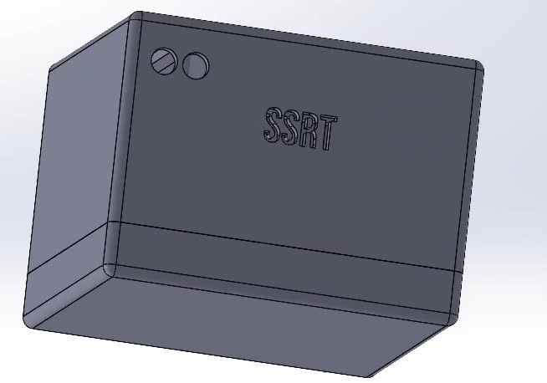
ENCLOSURE DESIGN

Slide 13
CHALLENGES AND SOLUTIONS
  Users being concerned they might forget to switch off the fan if they do not see it working in the morning. - Using a RTC module to adjust the time periods device work.

Slide 14
DOES ANYONE
have questions?

Slide 15
THANK
you

